Slide 1

Elemental Clash
Diogo Silva-nMec: 108212
Introduction to Computer Graphics
2024/2025

Slide 2
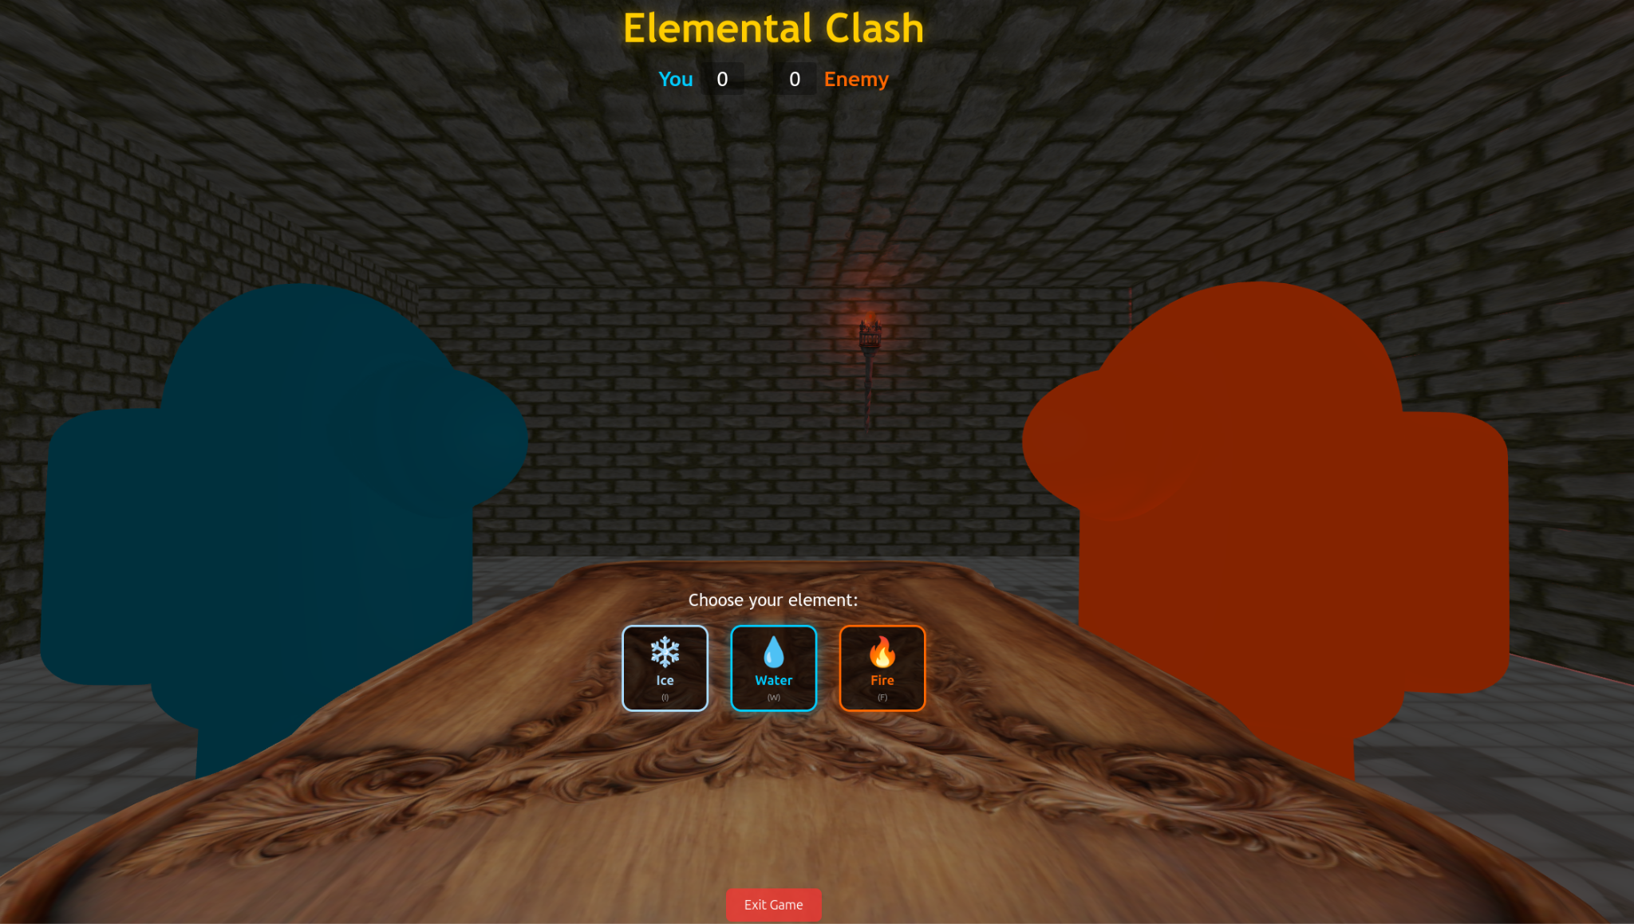
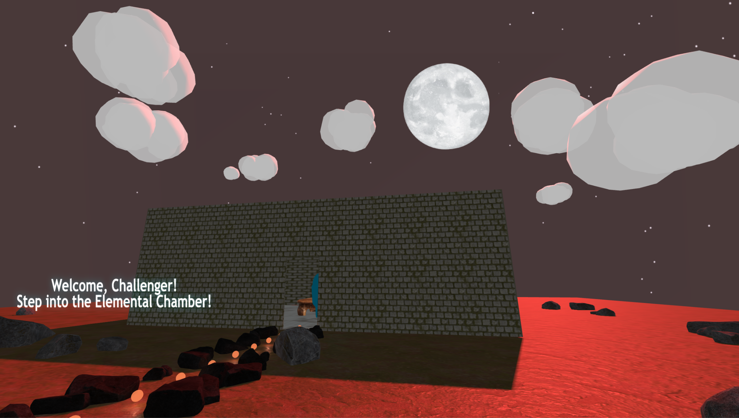
Main Ideas
-Rock-Paper-Scissors Style mini-Game
- 3D Open World to Explore
Using Keyboard and Mouse
- Move freely through environment
- Interact with other characters

Slide 3
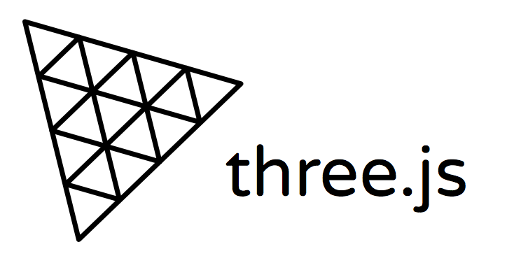
Three.js
The imports structure reinforces the readability and reusability, keeping the code more organized.
{ CanvasTexture } → Converts 2D canvas drawings into textures for 3D objects.
{ Vector3 } → Represents 3D positions and directions; essential for movement, positioning, and physics.
{ Group } → Lets you group multiple 3D objects to manipulate them as one.
{ Box3 } → Used for bounding box calculations, crucial for collision detection and spatial logic.
{ PlaneGeometry } → A basic flat surface geometry, often used for floors, walls, or UI elements in 3D space.

Slide 4
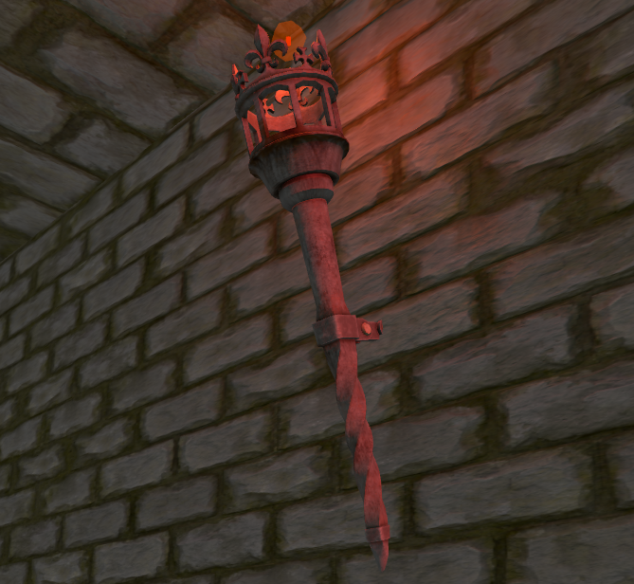
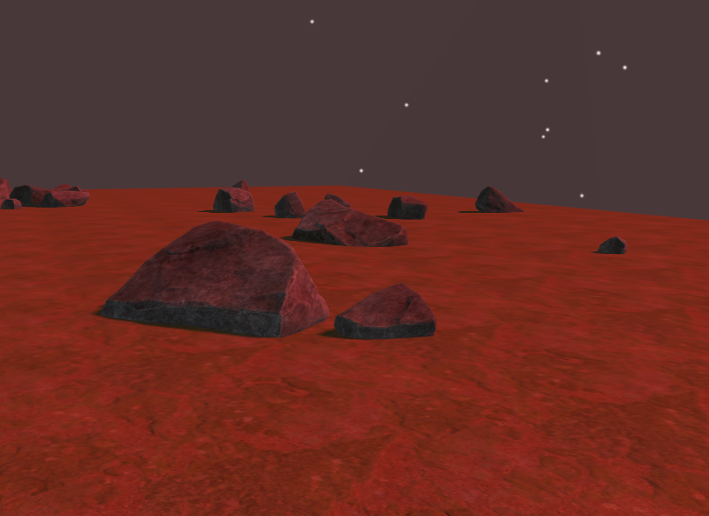
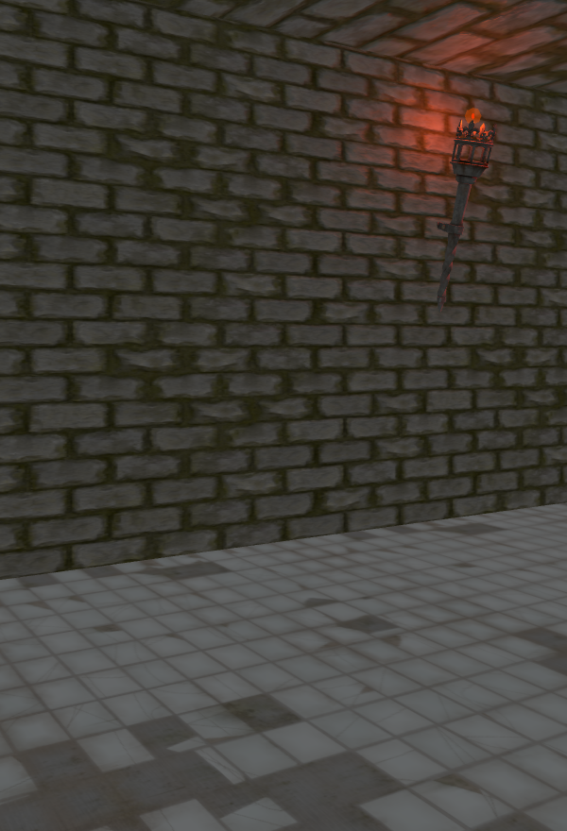
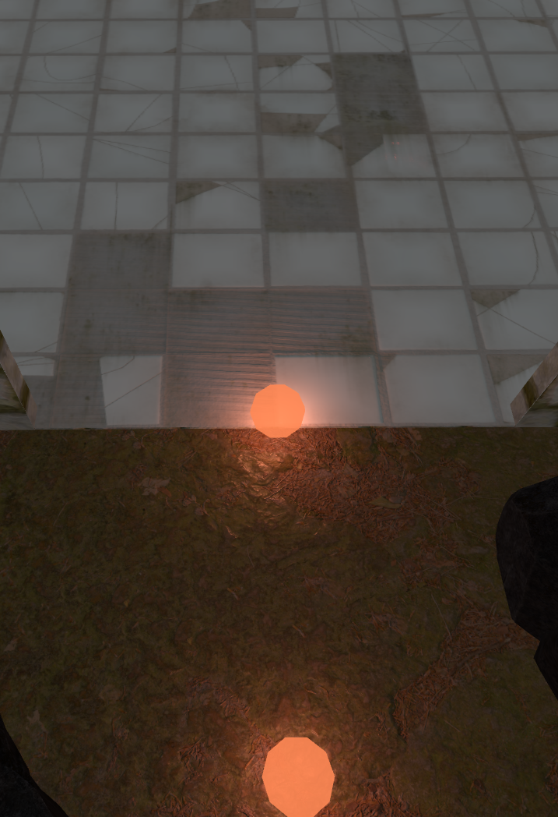
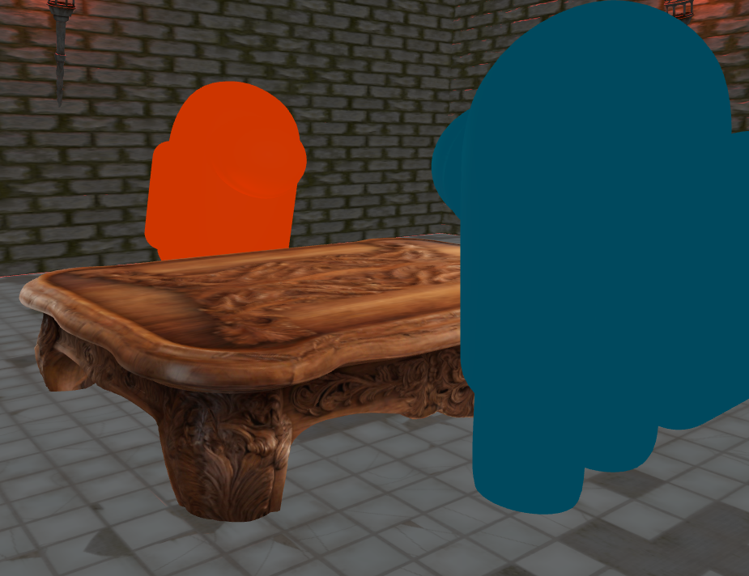
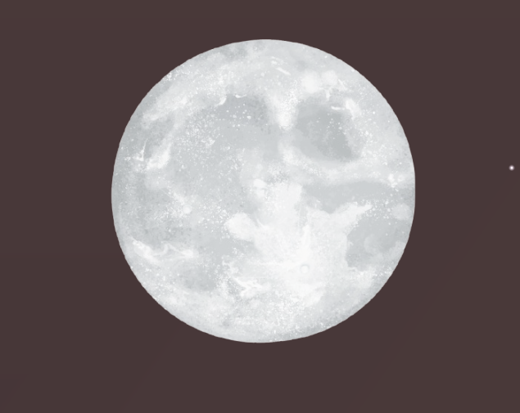
Models and Textures
Wall Torch
Rocks
Table
Characters
Ground
floor
Walls
Moon

Slide 5
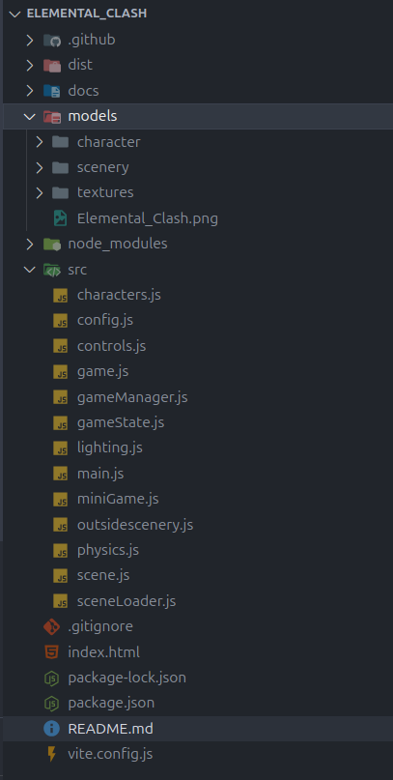
Organization
….
│
├── Game UI & Overlays (scene.js, miniGame.js)
│ ├── createTextTexture() ← scene.js
│ ├── updateFloatingText()
│ ├── createSimpleVictoryDisplay() ← miniGame.js
│ ├── createVictoryOverlayWithCountdown()
│ └── showDefeatOverlay()
│
├── Mini-Game Logic (miniGame.js)
│ ├── initGame()
│ ├── makeChoice()
│ ├── determineWinner()
│ └── resetGame()
│
├── Game Flow Manager (gameManager.js)
│ ├── registerMiniGame()
│ ├── registerExitGame()
│ └── startMiniGame()
│
├── Game Logic and Transitions (game.js)
│ ├── startGame()
│ ├── updateCameraTransition()
│ └── startVictoryTransition()
│
├── Game State (gameState.js)
│ ├── checkTableProximity()
│ ├── updateGameLighting()
│ └── onRoomEntry()
│
└── Physics (physics.js)
├── setTableReference()
├── isCollidingWithWalls()
└── isInDoorway()
THREE.Scene
├── Environment (scene.js + sceneLoader.js)
│ ├── createTilesFloor()
│ ├── createWallEnvironment()
│ ├── createMetalCeiling()
│ └── createTable()
│
├── Outside Scenery (outsidescenery.js)
│ ├── createOutsideScenery()
│ ├── createRocks()
│ ├── addClouds()
│ ├── create Moon()
│ └── updateMoonBillboard()
│
├── Lighting (lighting.js)
│ ├── setupBaseLighting()
│ ├── addWallTorches()
│ └── updateTorchLights()
│
├── Characters (characters.js)
│ ├── setupCharacters()
│ ├── animateCharacter()
│ └── getCharacters()
│
├── Player Controls (controls.js)
│ ├── initControls()
│ ├── updateMovement()
│ └── updateCameraRotation()
│
……

Slide 6
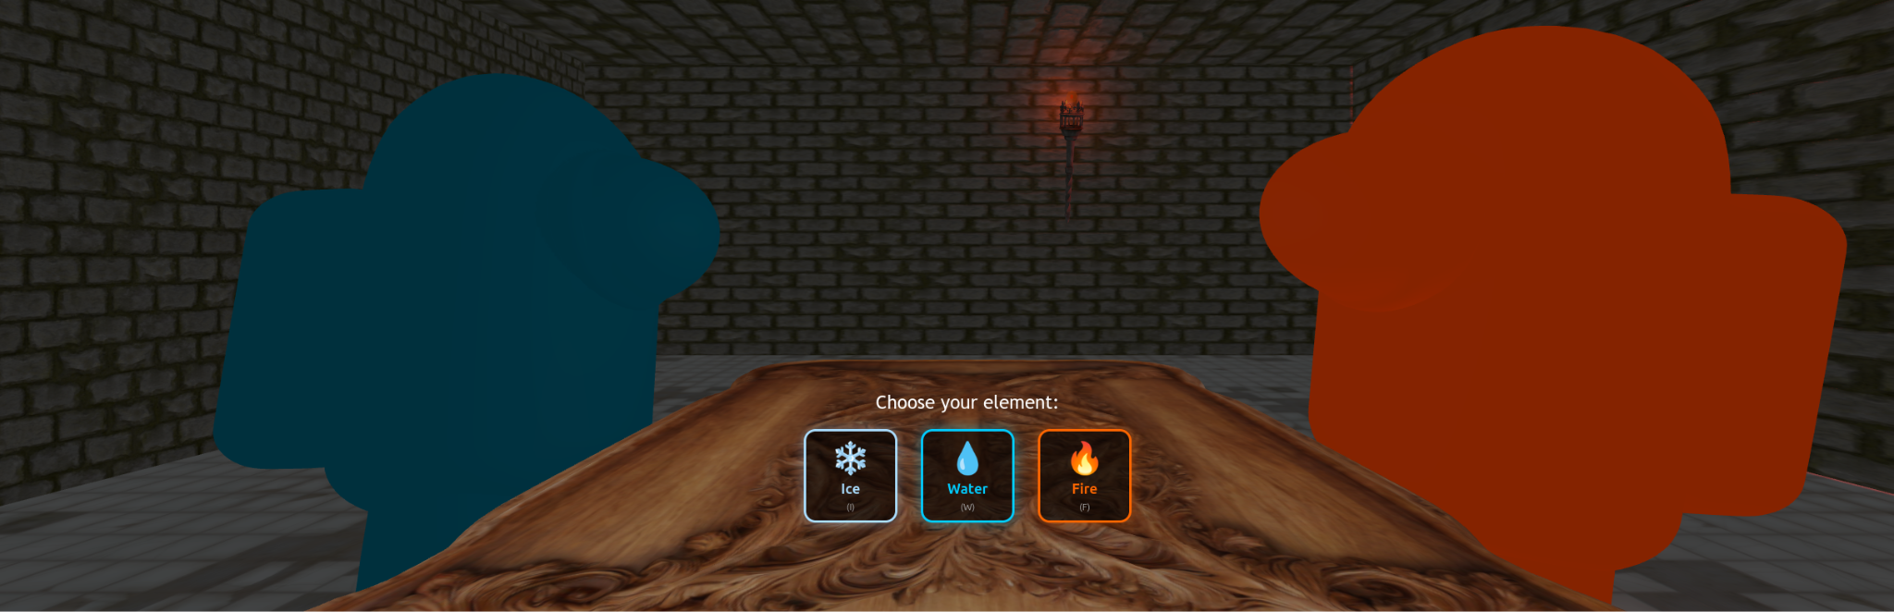
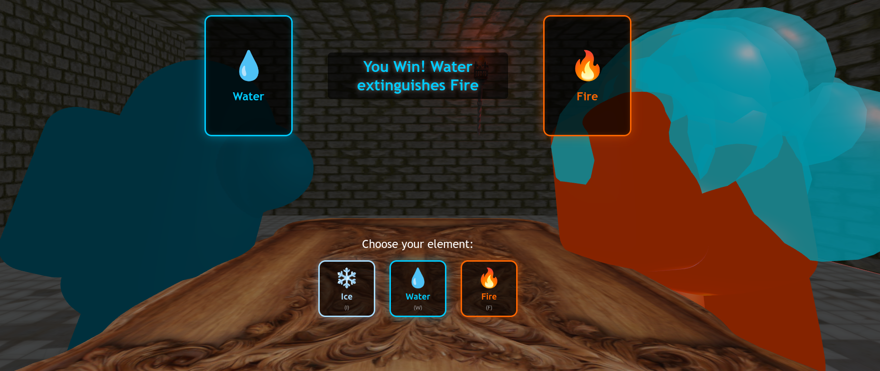
Animations
Character:
- bobAnimation()
- thinkingAnimation()
- tiltAnimation()
- jumpSpinAnimation()
- slumpAnimation()
miniGame:
- updateCard()
- makeChoice()
- startVictorySequence()
- showDefeatOverlay()

Slide 7
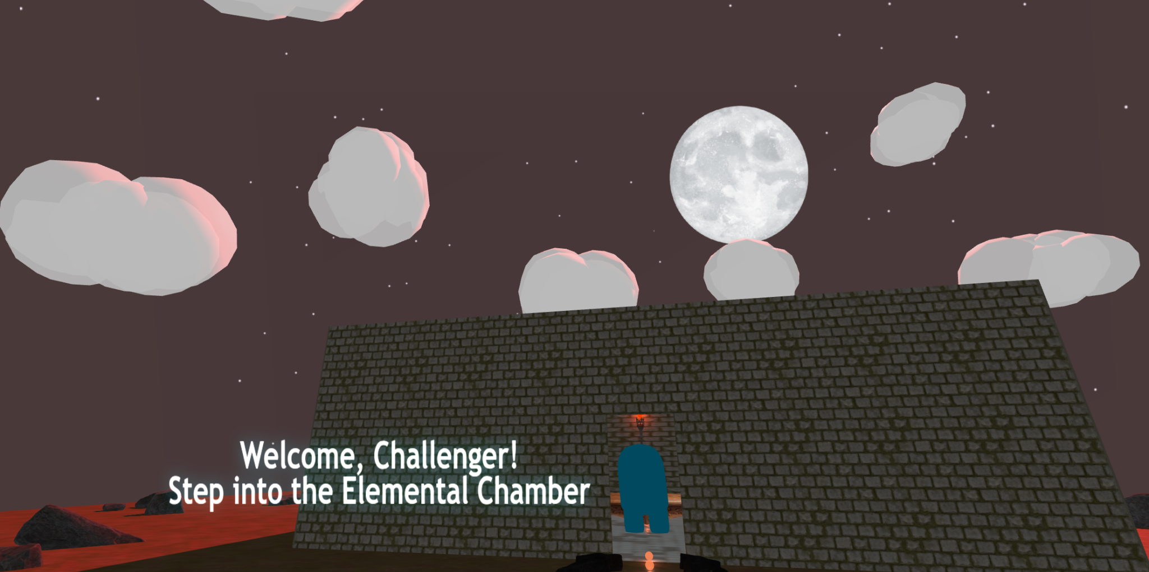
Animations
outsideScenery:
- animateClouds()
- updateMoonBillboard()
- updateFloatingText()

Slide 8
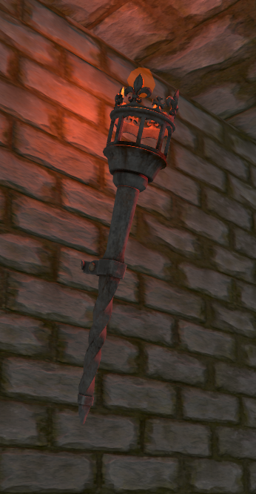
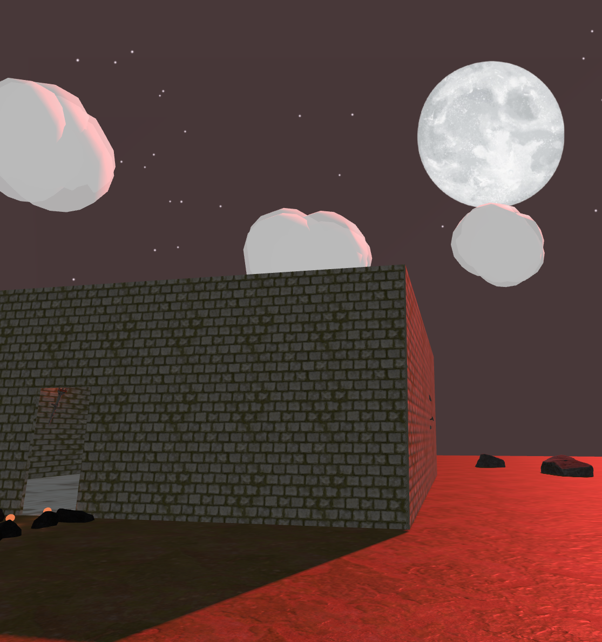
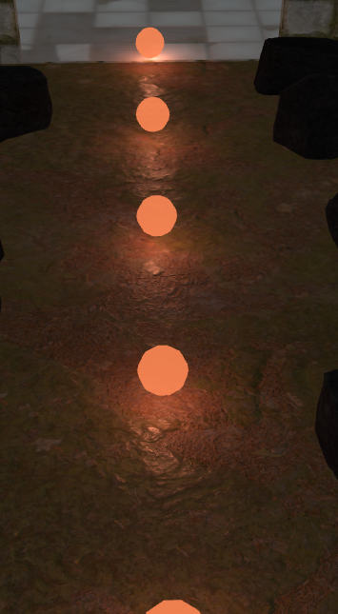
Lightning
- THREE.AmbientLight
- THREE.PointLight
updateTorchLights()
- updateMoonBillboard()

Slide 9
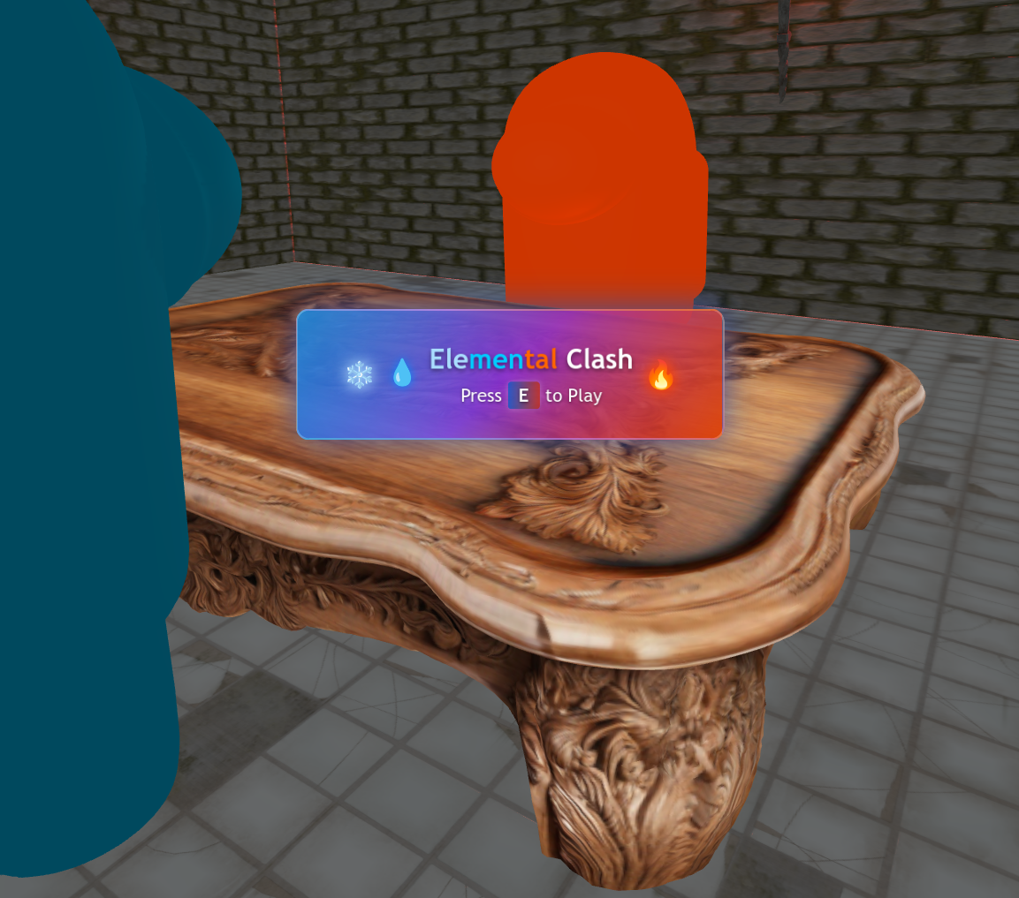
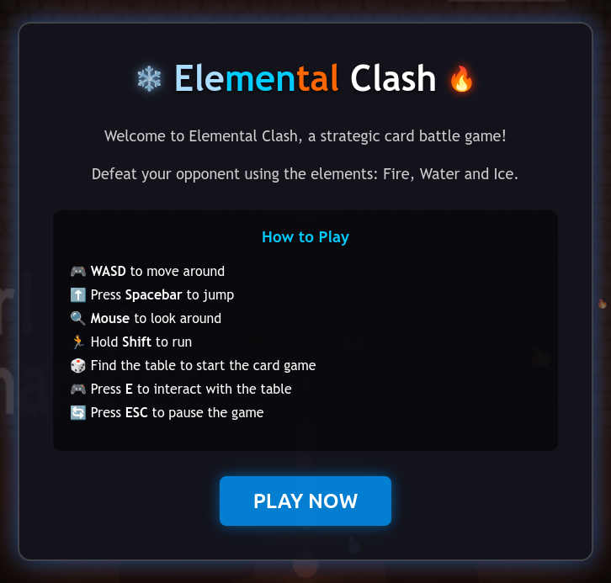
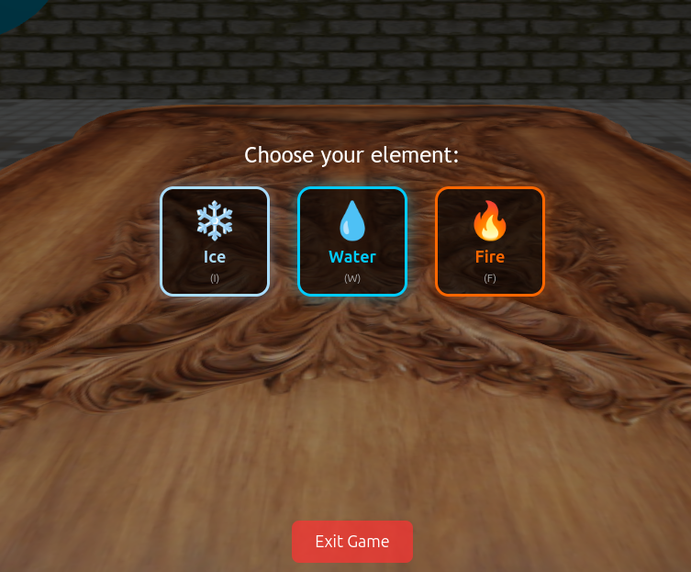
User Interaction

Slide 10
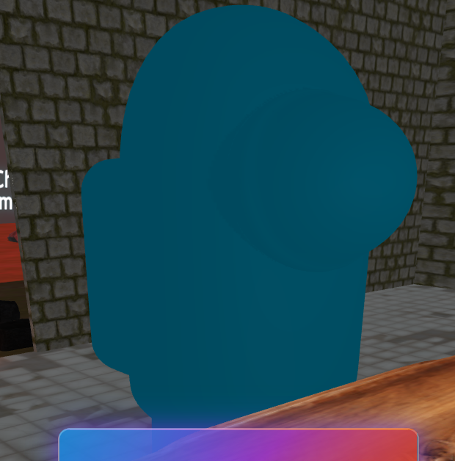
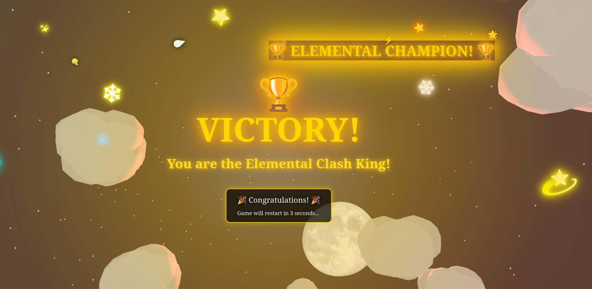
Difficulties
- Criação de Textos e Modelos 3D através de Canvas HTML, convertidos em THREE.Texture
[Texturas/Modelos muito pesados]

Slide 11
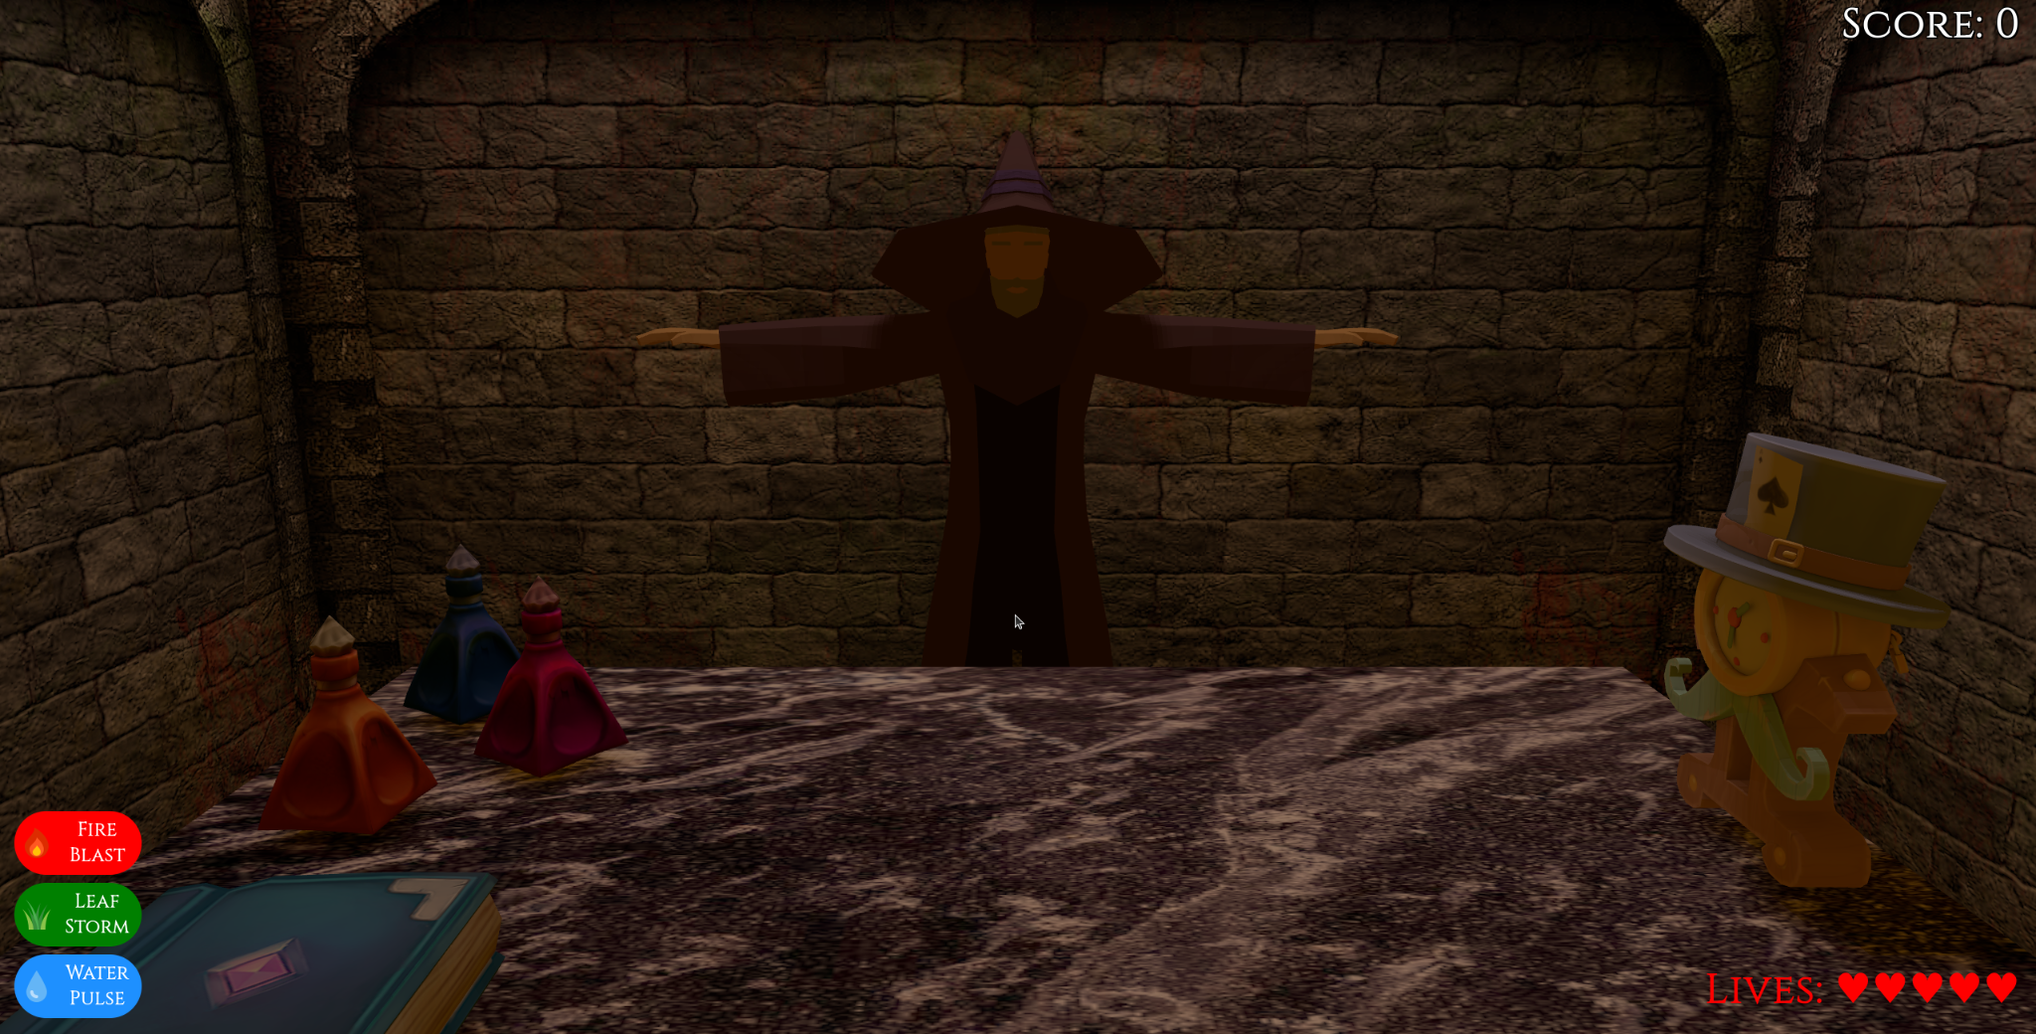
Conclusion
Main Reference: https://g0ncalocunha.github.io/wizard_showdown/index.html
https://diogozeca.github.io/Elemental_Clash/

